Slide 1
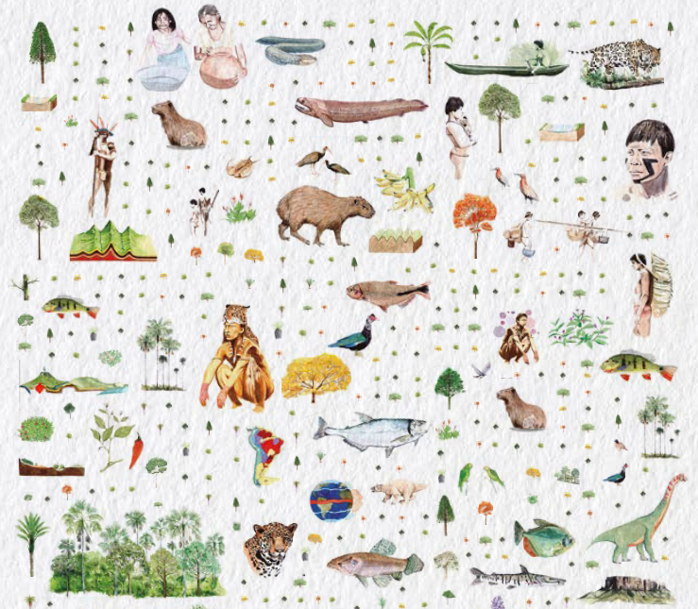
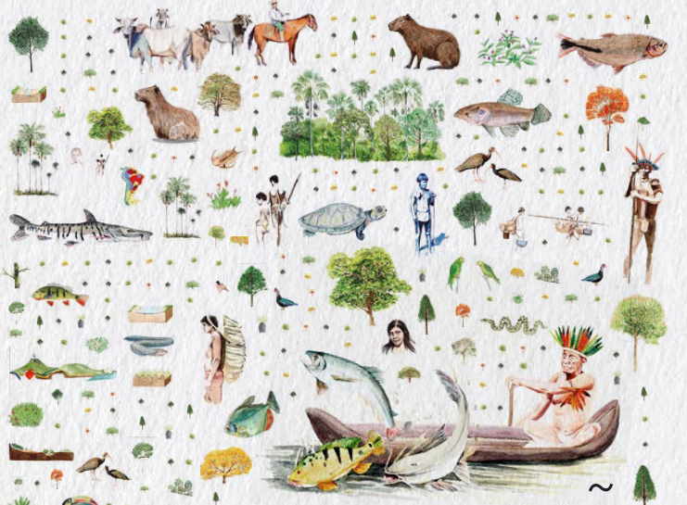
Functional ecology and functional diversity Paola Barajas Barbosa paola.barajas@idiv.de
Illustrations from Vásquez Cerón et al (2023). El gran libro de la Orinoquia Colombiana

Slide 2
Plan for the day
Introduction
Functional diversity is a facet of biodiversity
Functional ecology as a field of research of ecology
Trait-based ecology
Ecological significance of traits
Traits to understand species relation with the environment and evolutionary pathways
Functional diversity quantification (exercise)
Species-pairwise functional distances - approach sensu Anne Chao et al
Trait-value-based - approach sensu Blonder et al

Slide 3

Biodiversity facets
Biodiversity includes genotypic and phenotypic variation as well as ecological processes and evolutionary histories of organisms, communities and ecosystems across space and time.
Quantification of biodiversity strongly deals with the number of species and their abundances.
“Taxonomic facet”
Ecosystems plants, animals, fungi.
Image generated using image Creator Microsoft-Bing
Notes:
Because biodiversity includes different components, its quantification is challenging.

Slide 4
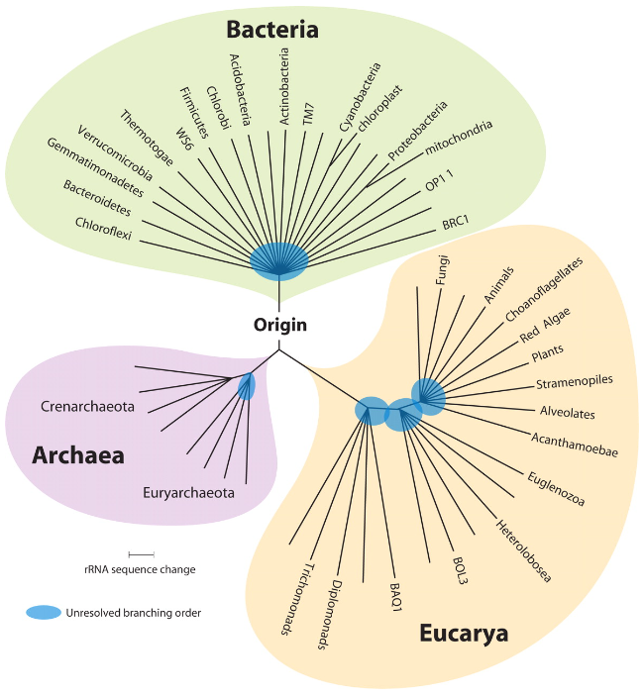
Biodiversity facets
Phylogenetic diversity
Evolutionary relationship across the biota, that is the tree of life.
Pace 2009. https://journals.asm.org/doi/10.1128/MMBR.00033-09

Slide 5
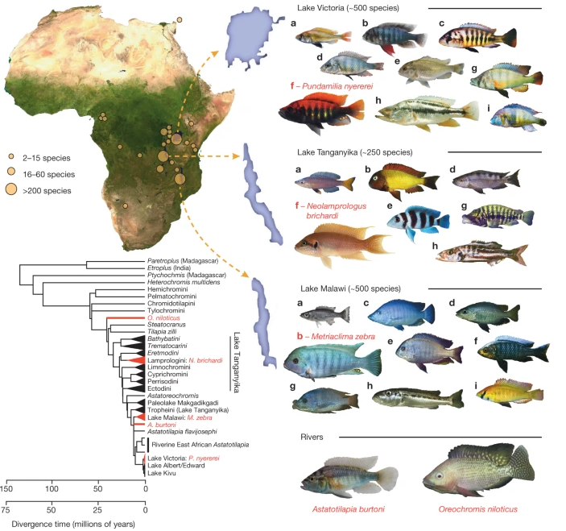
Biodiversity facets
Functional diversity
It deals with organisms, species, and communities’ functional characteristics in relation to their ecology and evolution.
Brawand et al 2014. Nature (https://doi.org/10.1038/nature13726)
Notes:
Functional characteristic example
Fig. 1 Map of Africa showing lakes in which cichlid fish have radiated. Right, the five sequenced species: Pundamilia nyererei (endemic of Lake Victoria); Neolamprologus brichardi (endemic of Lake Tanganyika); Metriaclima zebra (endemic of Lake Malawi); Oreochromis niloticus (from rivers across northern Africa); Astatotilapia burtoni (from rivers connected to Lake Tanganyika). Major ecotypes are shown from each lake: a, pelagic zooplanktivore; b, rock-dwelling algae scraper; c, paedophage (absent from Lake Tanganyika); d, scale eater; e, snail crusher; f, reef-dwelling planktivore; g, lobe-lipped insect eater; h, pelagic piscivore; i, ancestral river-dweller also found in lakes (absent from Lake Tanganyika). Bottom left, phylogenetic tree illustrating relationships between the five sequenced species (red), major adaptive radiations and major river lineages. The tree is from ref. 4, pruned to the major lineages. Upper timescale (4), lower timescale (32). Photos by Ad Konings (Tanganyika a, b, d, e, g, h; Malawi a, c, d, e, f, g, h, i), O.S. (Victoria a–g, i; Malawi b), Frans Witte (Victoria h), W.S. (Tanganyika f), Oliver Selz (Victoria f, A. burtoni), Marcel Haesler (O. niloticus).

Slide 6

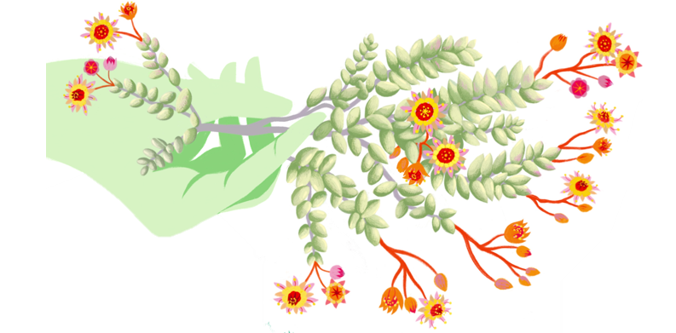
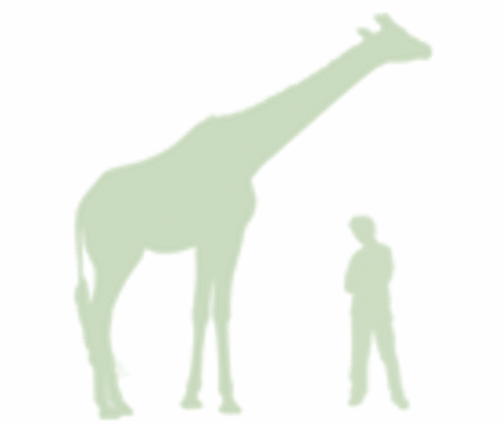
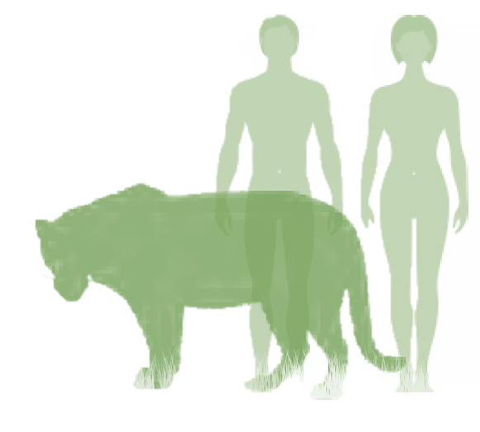
Biodiversity facets
Functional diversity
It deals with organisms, species, and communities’ functional characteristics in relation to their ecology and evolution
E.g., Body mass or size
Notes:
Functional characteristic example: body mass.

Slide 7
Today we focus on the functional facet of biodiversity Its ecological importance relates to communities and ecosystem dynamics
Tilman 2001; Bello et al 2021

Slide 8

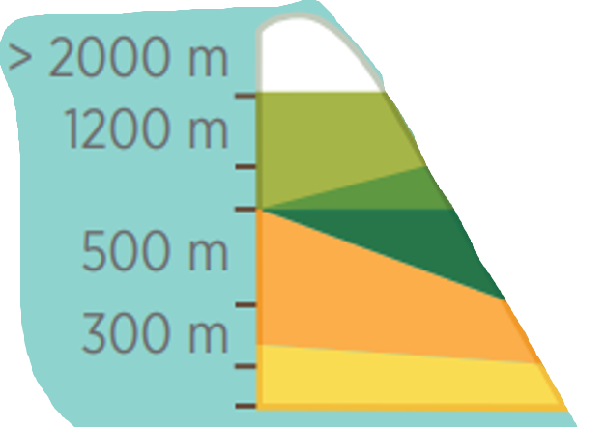


Functional Ecology
Sub-discipline of ecology
Studies the ecological role and function of species, communities and ecosystems
Based on organisms’ characteristics that relate to what they do in their environment
https://www3.gobiernodecanarias.org/medusa/ecoescuela/recursosdigitales/files/formidable/Pisos-Tenerife.pdf
Notes:
Functional ecology is a relatively newly defined discipline, but ecologists have been investigating organisms functional characteristics for centuries.
Example of plants along a steep elevation gradient. Tenerife Canary Islands.
Different ecosystems along the elevational gradient have different env. conditions. Plants are different in each elevational belt and have different ecological strategies as a respond to the env.
E.g., coastal ecosystem (warm, salty), forest (warm and humid) and summit (cold and dry).

Slide 9
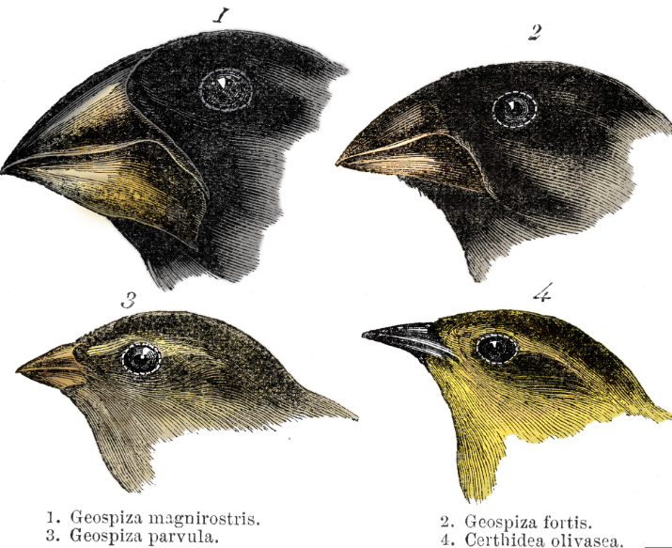
Functional Ecology
Based on organisms’ characteristics that relate to what they do in their environment
Elizabeth Builes
https://www.yourgenome.org/facts/what-is-evolution/
Notes:
The theory of evolution by Darwin is based on his observations of birds and plant traits in the Galapagos.
Animals from the “same species” look different because they have adapted to different environments (‘Environmental filter´).
Evolution in isolation and the environment (resources) shaped bird’s functions.
Different beak shapes allowed birds to exploit specific food resources on each islands. Beak characteristics better suited for acquiring food in their environments had higher survival rates and reproductive success.
Leading to an accumulation of traits in each finch population.

Slide 10
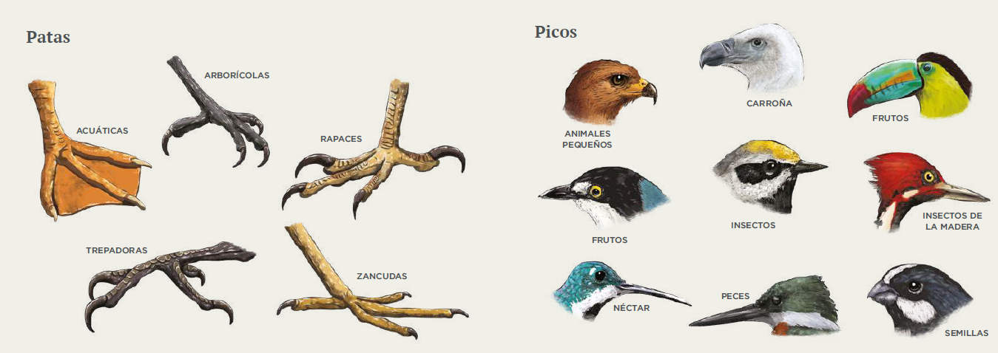
Functional Ecology
Feet
Beaks
Seizing prey
Swimming
Tearing meat
Fruits
Fruits
Wood insects
Perching
Fruit
Insects
Walking
Nectar
Fishing
Seeds
Illustrations from Hernández-Jaramillo et al (2019). Bosque seco tropical. Guía de especies
Notes:
Examples of organisms’ characteristics that relate to what they do in their environment

Slide 11
Functional Ecology
“Function” is the action of performing
Relates to the role of organisms in their environment
Reflects natural selection (environmental filters or competition) on an organism.
“Function” (scale) specific activity carried out by part of a whole or by the whole itself, e.g., species and ecosystems.
Calow, P. 1987. Towards a Definition of Functional Ecology. Functional Ecology, 1(1), 57; Garnier et al 2016
Elizabeth Builes
Notes:
What does function mean?

Slide 12
Functional Ecology
What does functional diversity measure?
Differences among species are quantified using morphological, physiological behavioral characteristics (“traits”) that impact how organisms respond to the environment, affect other trophic levels, and influence ecosystem processes and properties.
Lavorel and Garnier 2002 Func. Ecol; Violle et al 2007 Oikos
Brawand et al 2014. Nature https://doi.org/10.1038/nature13726
Elizabeth Builes

Slide 13

Functional Ecology
Example of trait variation between organisms’
Different canopy heights and body sizes
Elizabeth Builes
Dı́az & Cabido 2001 Trends Ecol. Evol.; Mason et al 2005 Oikos
Notes:
Functional diversity, in other words, the variation of traits between organisms, can be used to address a great number of ecological questions.

Slide 14
Exercise click: Jam board
Notes:
Add a trait to an organism
https://jamboard.google.com/d/1-v7GAf6vIxIlonpnM998p893bEuvCiHkM7hW_ZN_My0/viewer?pli=1

Slide 15
Traits and trait-based ecology
Illustrations from Vásquez Cerón et al (2023). El gran libro de la Orinoquia Colombiana

Slide 16
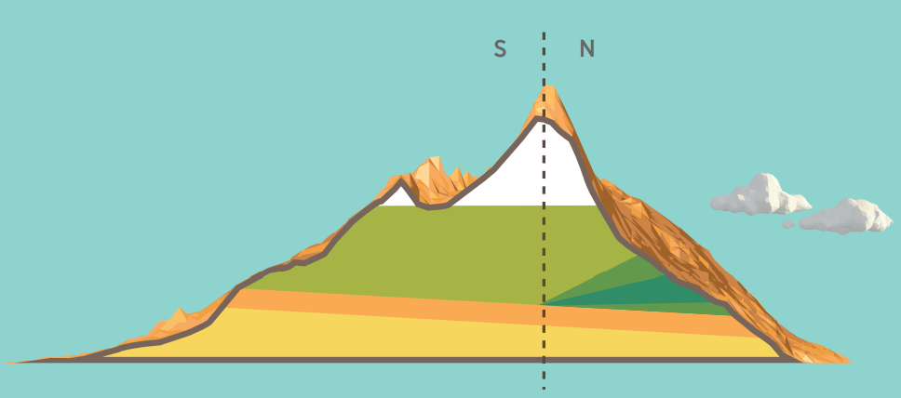
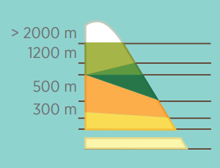
‘Schimper world (1898)’: Certain species are more successful in different parts of the landscape than other because their attributes “traits”
Climate filter species based on their traits, e.g., an elevational gradient
https://www3.gobiernodecanarias.org/medusa/ecoescuela/recursosdigitales/files/formidable/Pisos-Tenerife.pdf
Westoby & Wright 2006
Notes:
How did ecologists and biologists start thinking about functional diversity?
E.g., German botanist Andreas Schimper (Pflanzengeographie auf Physiologischer Grundlage 1898).
In his world, some plant species are more successful in different parts of the landscape and this is because they have different quantitative characteristics.
Schimper’s world is set in real physical geography, along gradients of rainfall, temperature, and geomorphology.
Plant stems, canopy architecture, foliage are so influential in terrestrial ecosystems that Schimper world should be important for any ecologist.

Slide 17
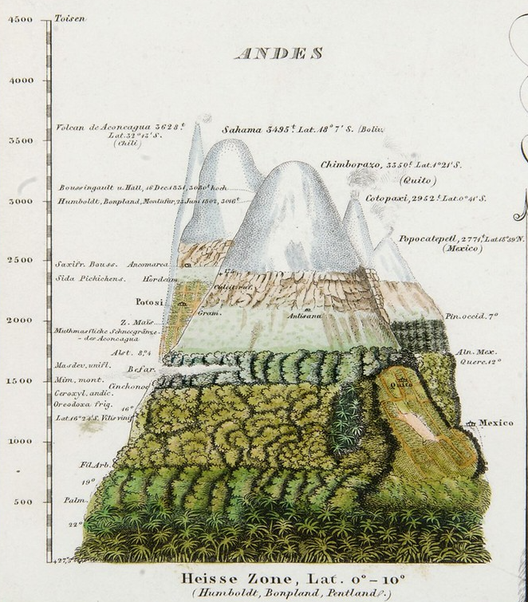


Alexander von Humboldt
1769-1859
https://vividmaps.com/astonishing-vintage-illustrations-of-mountain-vegetation/
https://www.humboldt-foundation.de/entdecken/alexander-von-humboldt
Notes:
E.g., German naturalist and geographer also understood the role the env shaping species characteristics.
Humbold’s explorations on the tropical Andes allow to understand how the env. shapes the functioning of plant diversity.
Response of plant trait diversity to the env conditions

Slide 18
What are traits?
“Morphological, physiological, phenological characteristics of organisms that impact growth, reproduction and survival of individuals”
(Violle et al 2007)
“Traits affect how organism respond to environmental factors and affect ecosystem properties” (Lavorel & Garnier 2002)

Slide 19


Functional traits
Examples
Plant stature
Seed mass
Leaf area
Pollination syndrome (categorical)
Body size
Beak length
Wing length
Diet (categorical)
http://www3.gobiernodecanarias.org/medusa/wiki/index.php?title=Categor%C3%ADa:Flora_canaria
Notes:
- Examples of traits that we can measure in functional ecology.
- Functional traits allow to score species along a continuum of similarity/dissimilarity.
Some species share functional traits (they are the same size, eat the same thing, etc.) and thus are more similar than others that do not.
Now, if we apply functional traits to the above example, we might find the dissimilarity among species looks more like this for the two communities:

Slide 20
Functional traits Ecological functions
Seed mass
Vegetative height
Leaf size
Specific leaf area (SLA)
Leaf nutrients concentrations
Density root tissues
Toor depth or root length
Fecundity
Light interception, competitive ability
Resource acquisition
Growth (fast, slow)
Absorption (nutrients, water)
Survival under drought
Garnier et al 2016
http://www3.gobiernodecanarias.org/medusa/wiki/index.php?title=Categor%C3%ADa:Flora_canaria
Notes:
Specific leaf area (SLA; leaf area/leaf mass) important trait. SLA determines how much new leaf area to deploy for each unit of biomass produced.
Under elevated CO₂, any storage of the extra carbohydrate in the leaves or any reallocation of biomass to thicker leaves would tend to increase leaf mass more than leaf area, thereby decreasing SLA.
MORE MASS THAN AREA = low SLA
Garnier, E., Navas, M. L., & Grigulis, K. (2016). Plant functional diversity: organism traits, community structure, and ecosystem properties. Oxford University Press.

Slide 21
Trait-based functional ecology
Why are traits useful?
They facilitate comparisons: operability of systems around the world, regardless of their compositions (Raunkiaer 1937; Grime 1979).
Ecosystem management (e.g., wetlands, shrubland, forests) could be compared to different floras or geographical regions.
Notes:
Understand how systems around the world, regardless of their unique compositions, operate
We want to know how climate, across the globe, affects which species are and are not able to establish.
Such analysis compares the species traits and not only species identities. (Keddy, P. A. (1992). A pragmatic approach to functional ecology. Functional Ecology, 6(6), 621-626).

Slide 22
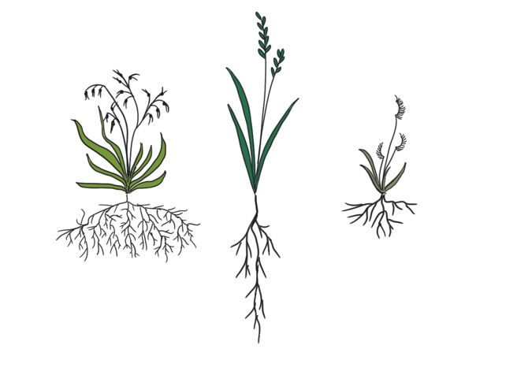

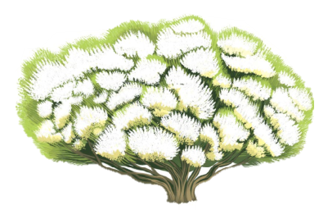
Trait combinations
Trade-off arise because evolutionary pressures select for specific traits in specific environments
Example: species with high specific leaf area may be best suited to thrive in resource-rich environments, whereas those with low SLA might be best at withstanding drought
Leaf thickness inform about how plants cope with dry environments
Herb
High specific leaf area
Low tissue density
FAST growth
Succulent
@MagdaGarbowski
Bush
Low specific leaf area
High tissue density
SLOW growth
https://www3.gobiernodecanarias.org/medusa/ecoescuela/recursosdigitales/files/formidable/Pisos-Tenerife.pdf
Notes:
Trait correlation/synchronization
Organism have many traits/ characteristica and they often times are correlated.

Slide 23
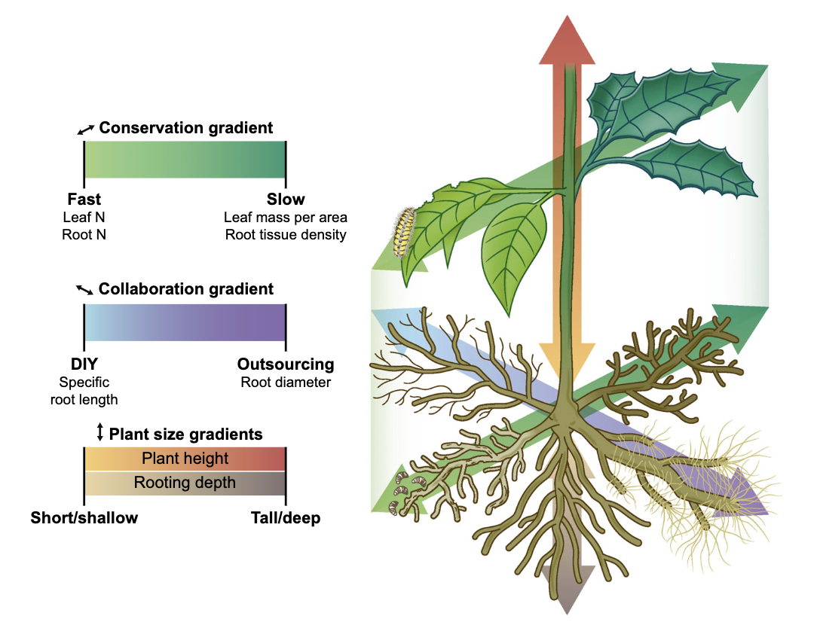
Plant ecological strategies
Weigelt et al 2021
Notes:
Coordinated variation in traits result in specific plant strategies.
The most studied strategy is that of the leaf economic spectrum which demonstrates that species adopt either “fast” or “slow” strategies related to resource acquisition.
”Fast” species would have high N concentrations and high specific leaf area. These traits or characteristics allow it to grow quickly. However, the leaves these species produce are not tolerant to stress and have short longevity. On the other side of this LES are slow species with high-density tissues and long leaf lifespans – these are often species more capable of withstanding stress.
Flimsy – lettuce/dandelion, resistant – pine trees, trees, shrubs
Recently root traits have been incorporated into this framework with two dominant axes of variation: one related to the “fast-slow” spectrum in leaves with some plants optimizing rapid resource acquisition and others optimizing root longevity and another related to collaboration with mycorrhizal partners.
In addition, “size” axes exists above and below ground under which plants are either short or tall and have either shallow or deep roots. However, in this study, the largest assessment of whole-plant variation to date, aboveground maximum height and belowground rooting depth were not correlated, but independent axes.
Tree’s tipped over after wind storm

Slide 24
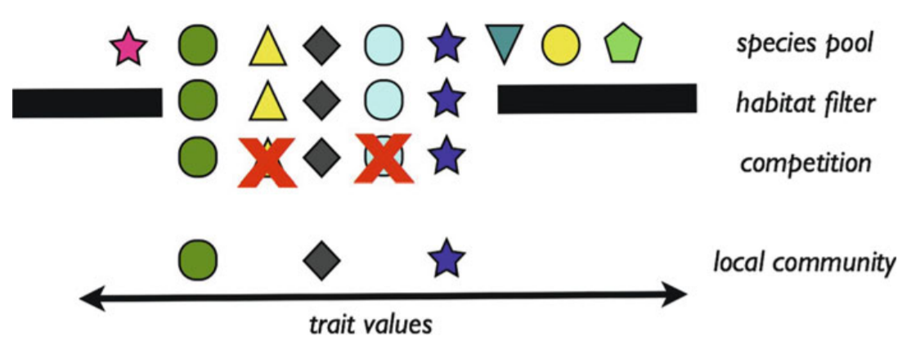
Trait-based ecology
Prediction of species arrival, persistence and coexistence in communities
Conceptual model of community
assembly in terms of species functional
traits (phenotypes)
Community assembly
Kraft & Ackerly 2014
Notes:
Community assembly process by which local communities assemble through the colonization and interaction of species from a larger, regional pool of species.
Within this regional pool, the composition of species may be shaped by a combination of deterministic processes, such as competition or environmental filtering, or stochastic processes such as ecological drift.
Conceptual model of community assembly in terms of species functional traits (phenotypes).
A local community in relation to the species pool of potential colonists. Habitat filtering is often hypothesized to limit the range of traits that can successfully survive and establish at a site, as well as sometimes shifting the mean value relative to the species pool.
Competition, predicted to favor the coexistence of species that differed in resource use or requirements, reflected here in their functional traits. In the example here, competitive exclusion leads to a local community of species with trait values that are more dissimilar than species in the original species pool. Additional community assembly processes are not shown.

Slide 25
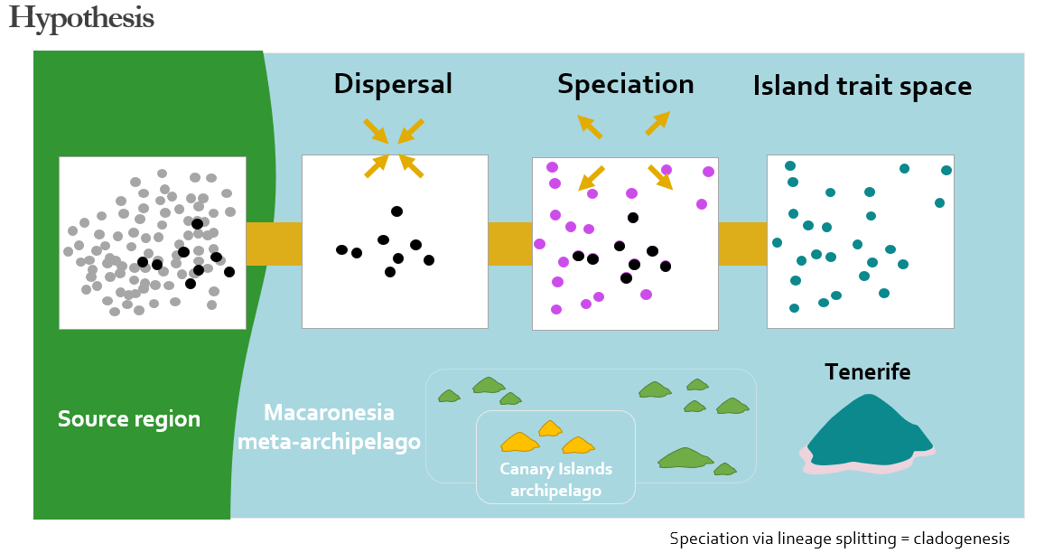
Trait-based ecology
Example: Assembly of functional diversity on an insular system
Hypothesis
Barajas Barbosa et al 2023
Notes:
Hypothesis
Dispersal (long-distance dispersal), limits the trait combinations on an OI because crossing oceans and adapting to new island environments is challenging for plants,
leading to species sharing similar trait combinations.
In contrast, speciation e.g., via lineage splitting (cladogenesis) to expand the trait space,
because islands are known for offering species new ecological opportunities (empty niches) where species can evolve trait combinations.

Slide 26
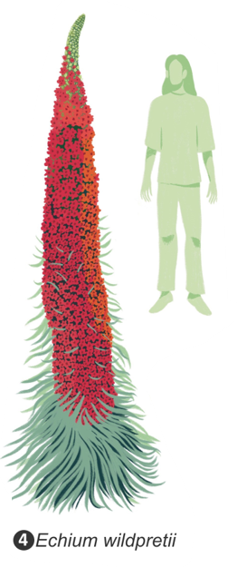
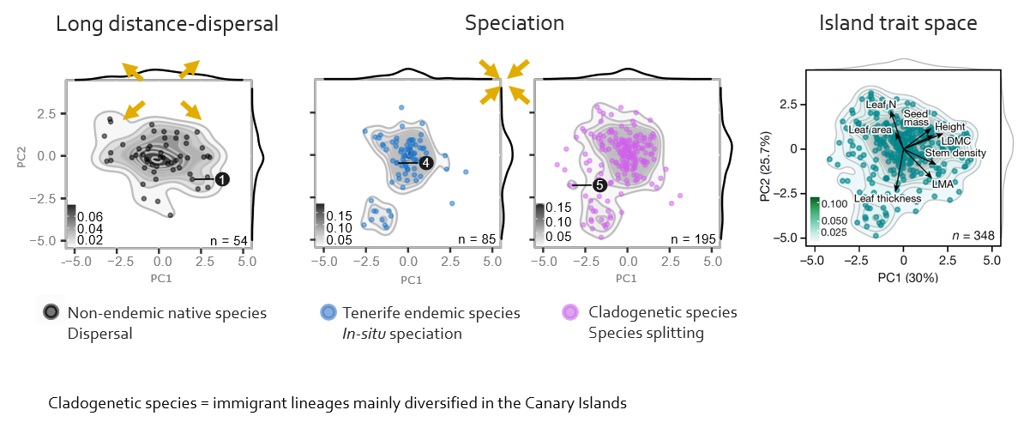
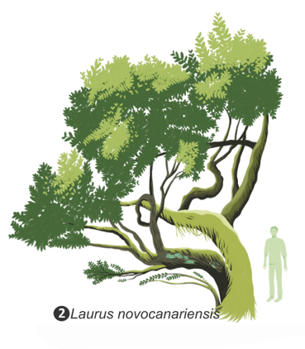
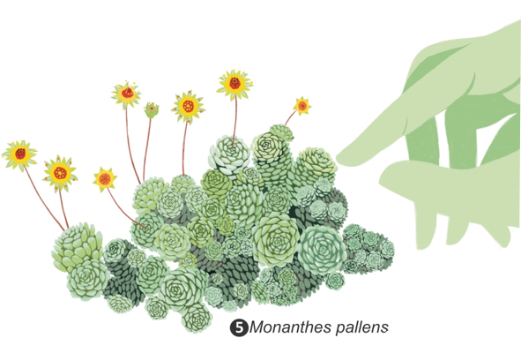
Trait-based ecology
Barajas Barbosa et al 2023
Notes:
Opposite to our hypothesis.
- Long distance dispersal, signaled by non-endemic natives species, spread across the island trait space.
MEANING dispersal contributes to a variety of forms on Tenerife, i.e., SHRBUS TREES AND HERBS.
- While speciation, in situ and species splitting, signaled by Tenerife endemic species and cladogenetic species, are not expanding Tenerife trait space.
MEANING speciation contributes mainly to plant form, SHRBUS – cluster core island trait space-
But also to small plants with think leaves, so succulents

Slide 27
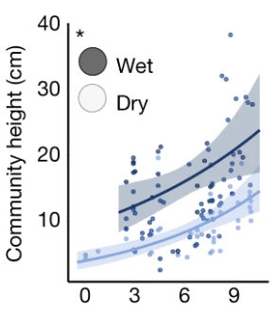
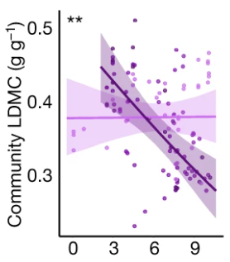
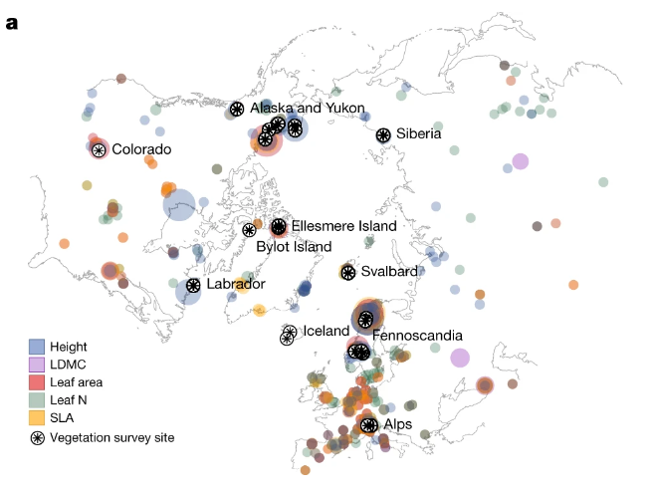
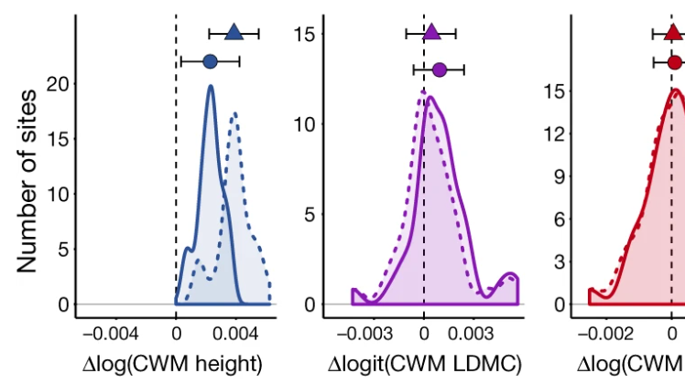
Trait-based ecology
Relationships in traits across temperature
Communities’ responses to climate change
Example: Tundra biome
Summer Temperature (°C)
Community trait change over time
Bjorkman et al 2018
Notes:
The Tundra is warming more rapidly than any other biome on Earth.
Changes in the structure and composition of tundra ecosystems.
They quantify the biome-wide relationships between temperature, soil moisture and traits.
The two trait relationships indicate that increasing temp (aka warming) can cause shifts towards communities of taller plants with more resource-acquisitive leaves (low LDMC), particularly where soil moisture is high.
Increasing community height overtime was mostly attributable to species turnover.
This turnover reflects the movement of tall species upward in latitude from local species pools in warmer microclimates

Slide 28
Challenges when working with traits
Lack of trait data
Time and high resource consuming
Traits are hard to standardize across taxa
http://www3.gobiernodecanarias.org/medusa/wiki/index.php?title=Categor%C3%ADa:Flora_canaria
Notes:
The traits I just showed you are collected in-situ.

Slide 29
Exercise click: Jam board Link the function to the organism’s trait
Notes:
Link the function to an organism’s trait
https://jamboard.google.com/d/1-v7GAf6vIxIlonpnM998p893bEuvCiHkM7hW_ZN_My0/viewer?pli=1

Slide 30
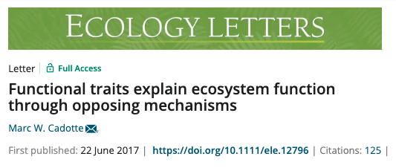
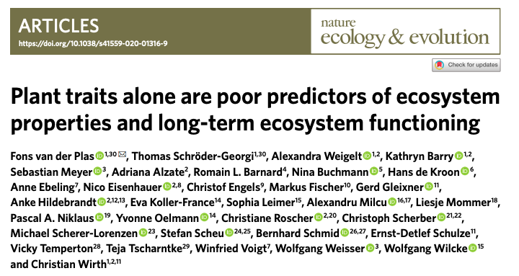
Take home messages
Trait based approaches are important complementary ways to understand biodiversity patterns and processes.
This is true when the traits selected can relate to species, communities, metacommunities and ecosystems dynamics. Trait-based

Slide 31
Take home message
Which traits should we measure?
We can start by asking what are the organism’s functions of interest and which traits (proxies) most effectively measure those functions.
Three main functions:
1. Resource acquisition
2. Ability to tolerate environmental extremes
3. Ability to compete with neighbours
Keddy 1992

Slide 32


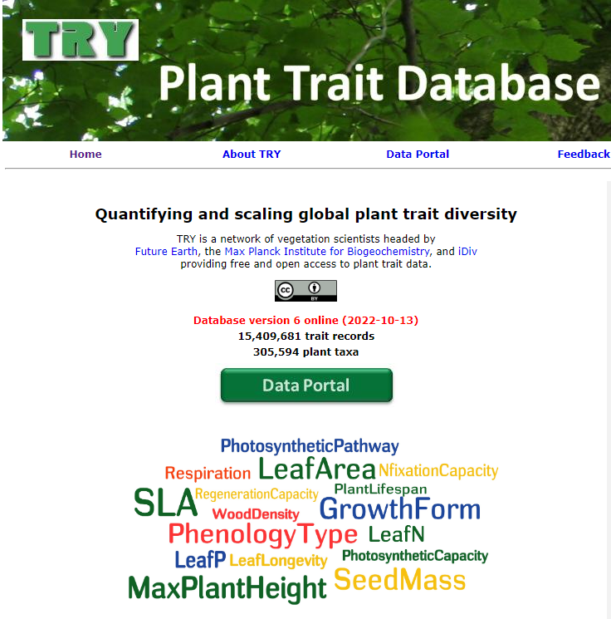
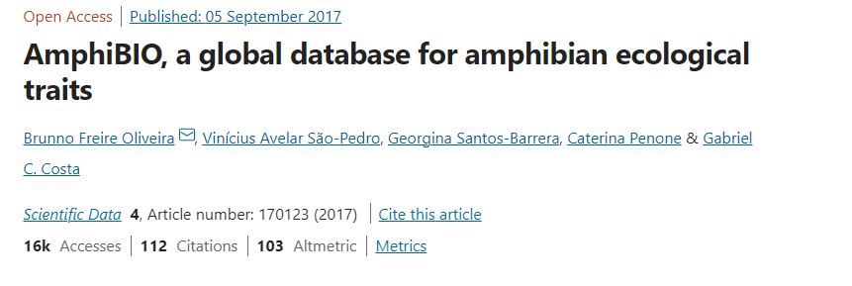

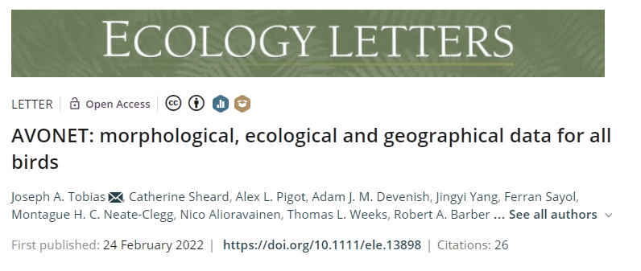
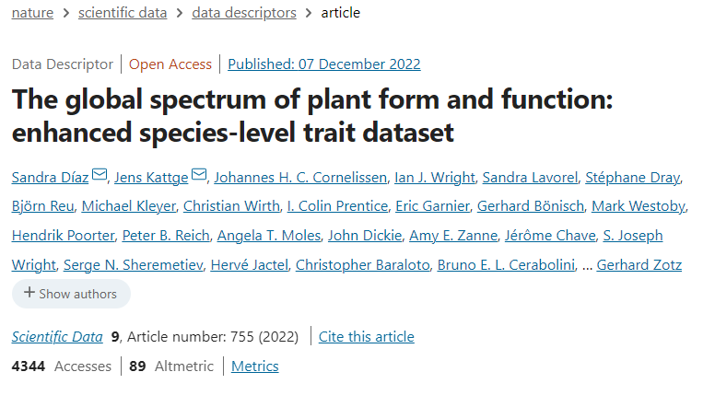
Where do I get trait data from?
Notes:
Examples of trait data sources

Slide 33
Let’s set up R for the afternoon session

Slide 34
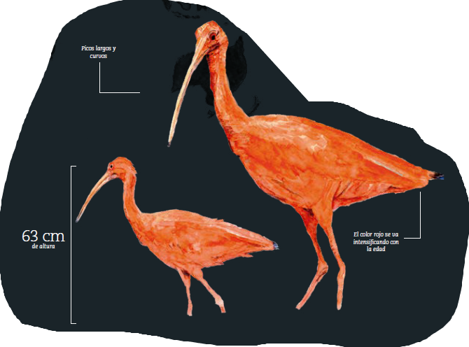
Afternoon session
Corocora
Eudocimus ruber

Slide 35
Plan for the day
Introduction
Functional diversity is a facet of biodiversity
Functional ecology
Trait-based ecology
The merit and ecological significance of traits
Functional diversity quantification
Species-pairwise functional distances - approach sensu Anne Chao et al
Trait-value-based - approach sensu Blonder et al

Slide 36
Functional diversity quantification I
Species-pairwise functional distances
sensu Anne Chao et al
Illustrations from Vásquez Cerón et al (2023). El gran libro de la Orinoquia Colombiana

Slide 37
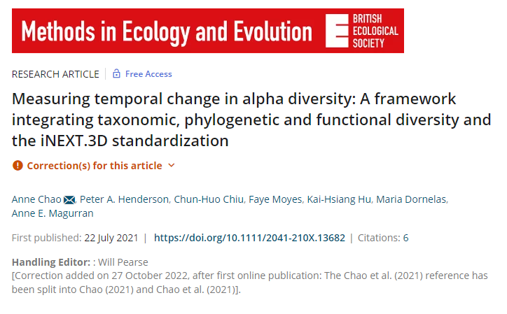
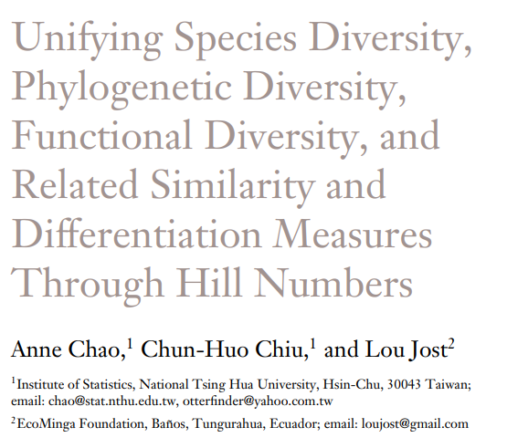
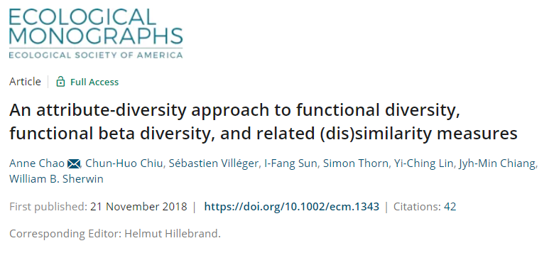

Slide 38
Chao et al – Distance-based approach
They developed functional diversity measures sensitive to
(1) Species abundances
(2) Trait-based species-pairwise functional distances
Their framework unifies ecologists’ measures of species diversity, with distance-based functional diversity by implementing Hill numbers.
Notes:
In short Distance-based approach.
Chao and Co integrate a framework of attribute diversity (i.e., the effective number of entities) based on Hill numbers of taxonomic entities (species) and functional entities (species-pairs with unit-distance between species).

Slide 39
Recap about Hill numbers
The Hill numbers are 'effective number of species' (Hill 1973; Jost 2006).
The parameter q determines the sensitivity of the measure to the relative abundance of species.
q = 0, is species richness. It counts species equally without regard to their relative abundances.
q = 1, is Shannon diversity, q = 1 counts individuals equally and weighs each species in proportion to its abundances.
q = 2, referred to as Simpson diversity, disproportionately favors dominant species.
Notes:
Hill numbers are a mathematically unified family of diversity indices (differing among themselves only by an exponent q) that incorporate relative abundance and species richness.

Slide 40
How are functionally distinct species defined?
Pool of species
Functional traits
Functional distance
between species
Sp1 Sp2 Sp3
Trait 1 Trait 2
Sp1 Sp2 Sp3
Site 2 site 1
Sp3 Sp2 Sp1
Sp3 Sp2 Sp1
Euclidean or Gower’s
distance
Modified from Maire et al 2015
Notes:
What is the additional information that FD metric includes?
A distance matrix, that is based on species traits.
Species by trait matrix
Distance matrix

Slide 41
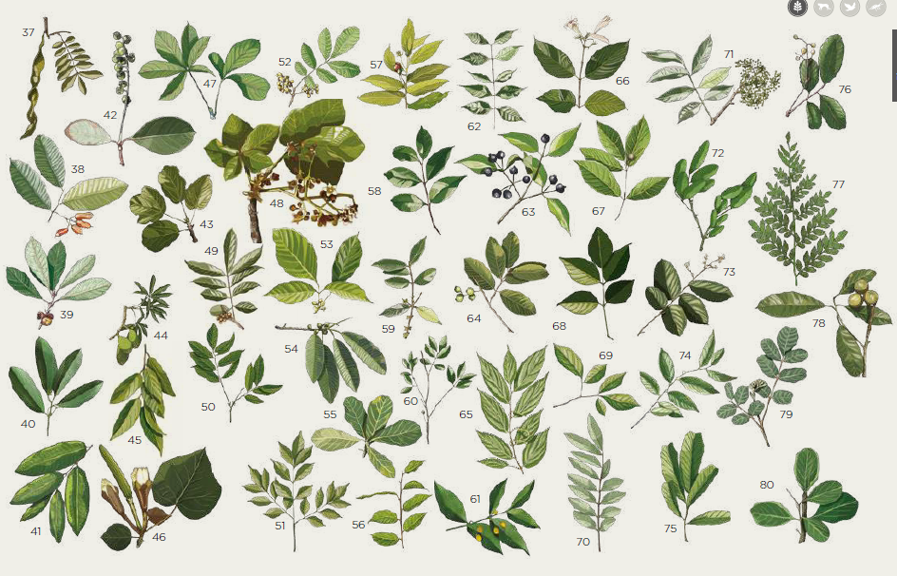
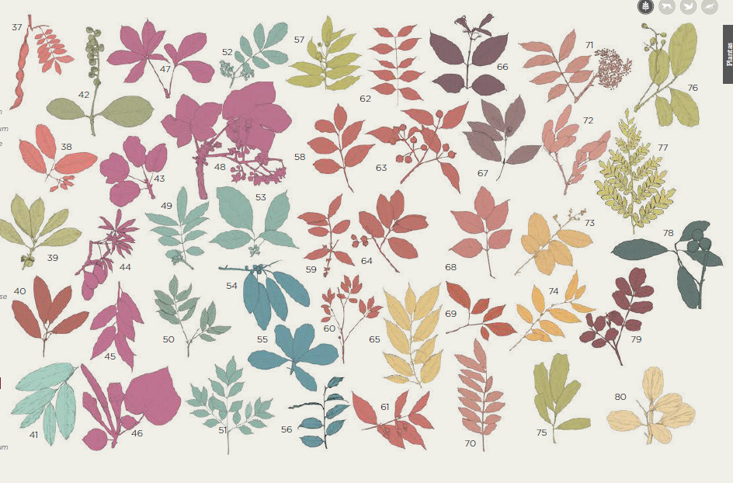
Level of threshold distinctiveness
Tau: level of threshold functional distinctiveness.
Determine a threshold level: any two species with distance greater than or equal to the specified threshold level will be functionally different.
Species are placed in a functional space with an specified pairwise distances.
Cluster species into “virtual functional groups”
Chao et al 2019
A
B
C
D
E
F
G
Illustrations from Hernández-Jaramillo et al (2019). Bosque seco tropical. Guía de especies
Notes:
Clustering algorithm: imagine that all species are placed in a functional space with specified pairwise distances, and now we cluster them into “virtual functional groups.” As in most statistical clustering algorithm, one must first determine a threshold level such that any two species with distance greater than or equal to the specified threshold level are in different clusters and vice versa. In our framework, the threshold level τ can be chosen to be any positive value, allowing the researcher to specify that any two species with distance beyond this specified level are regarded as functionally equally distinct species and in different functional groups. Moreover, we will later show that to avoid the three problems listed above, it is imperative to introduce this parameter. When the distance of two species is less than τ, we assume that only a proportion of the individuals of one species are functionally equally distinct from the other species at the threshold level τ

Slide 42
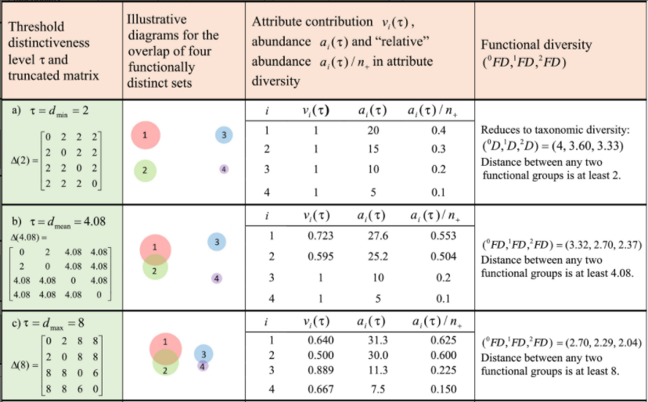
Level of threshold distinctiveness
Functional pairwise distance matrix
Effective number of distinct species
Threshold distinctiveness: Tau
Dmean - Chao’s proposed approach
Dmin
Taxo
i.e., mean distance of any two randomly chosen individuals based on the distance matrix
Dmax
Conventional
Chao et al 2019
Notes:
We used the suggested tau = Dmean (Chao et al., 2019), which is the mean distance of any two randomly chosen individuals based on the distance matrix (in contrast to the conventional approach which uses the maximum value of the distance matrix).

Slide 43
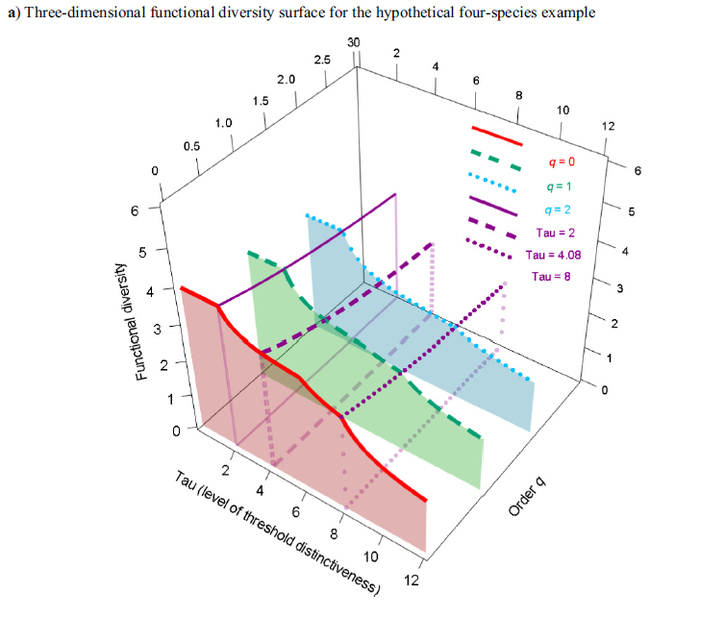
Chao et al 2019
Notes:
(a) The three-dimensional functional-diversity surface, which plots qFD(D(s)) as a function of diversity order q ≥ 0 and level of threshold distinctiveness s > 0.

Slide 44
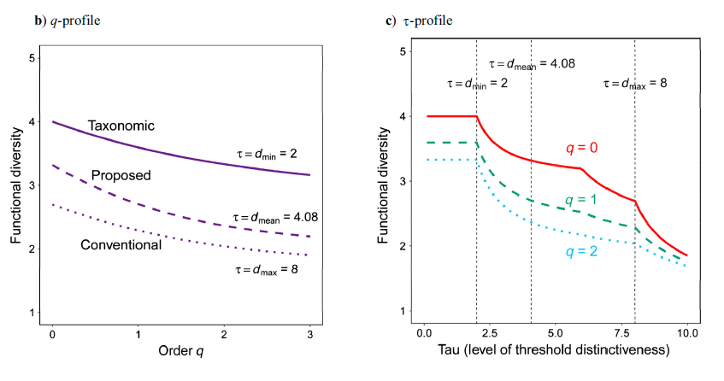
Chao et al 2019
Notes:
(b) The q profile, which plots qFD(D(s)) as a function of diversity order q for three levels of threshold distinctiveness (minimum, mean, and maximum):
s = dmin, dmean, and dmax for the four-species example described in the A simple hypothetical example section.
The taxonomic diversity corresponds to the profile with s = dmin whereas the conventional functional diversity corresponds to the profile at s = dmax.
(c) The s profile plots qFD(D(s)) as a function of level of threshold distinctiveness s, for q = 0, 1, and 2. The three dotted vertical lines correspond to different levels of threshold distinctiveness

Slide 45
Let’s do an exercise!

Slide 46
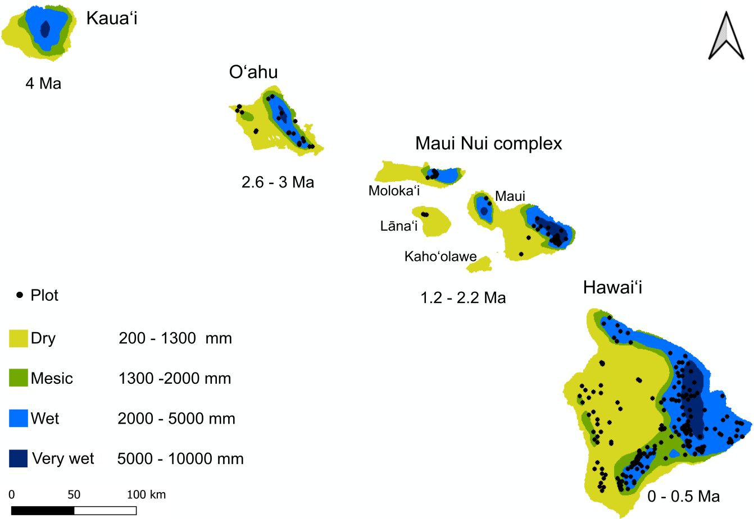
Hawaiian Forest Plot Data by Craven et al 2018
Open Nahele database
Notes:
https://doi.org/10.5061/dryad.1kk02qr

Slide 47
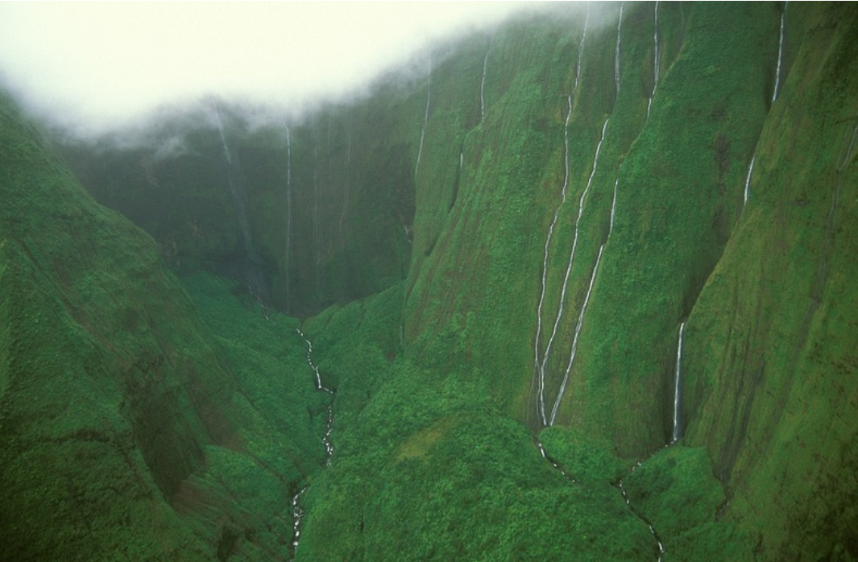
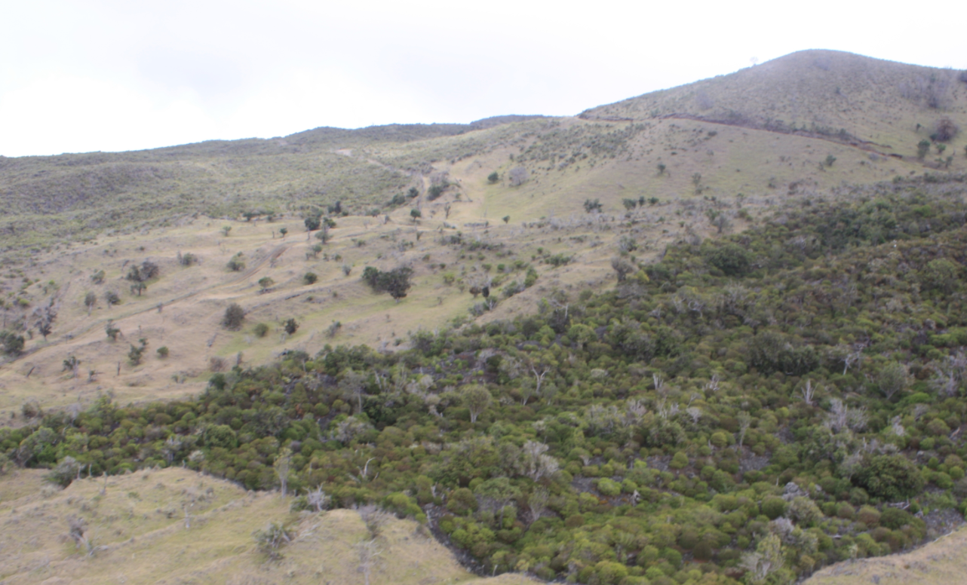
Hawaiian Forest Plot Data by Craven et al 2018
Mount of Tears Kaua’i
> 11000 mm of rainfall annually
Auwahi Dryland
Maui
Notes:
https://doi.org/10.5061/dryad.1kk02qr

Slide 48
Functional diversity quantification II
Trait-value-based approach sensu Blonder et al
Elizabeth Builes
Illustrations from Vásquez Cerón et al (2023). El gran libro de la Orinoquia Colombiana

Slide 49
Trait-value-based approach
Measures are calculated:
Species trait values directly (e.g., aggregated-trait value; Garnier et al 2004)
Accounting for their position in a multidimensional functional space built according to their trait values (e.g., volume occupied by species; Cornwell et al. 2006).
Notes:
Two ways

Slide 50
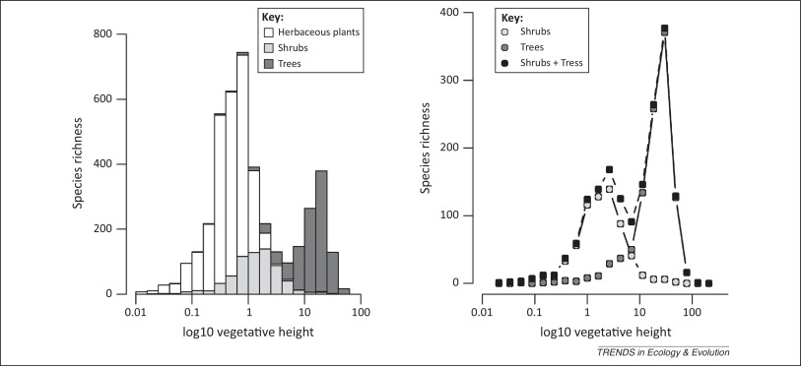
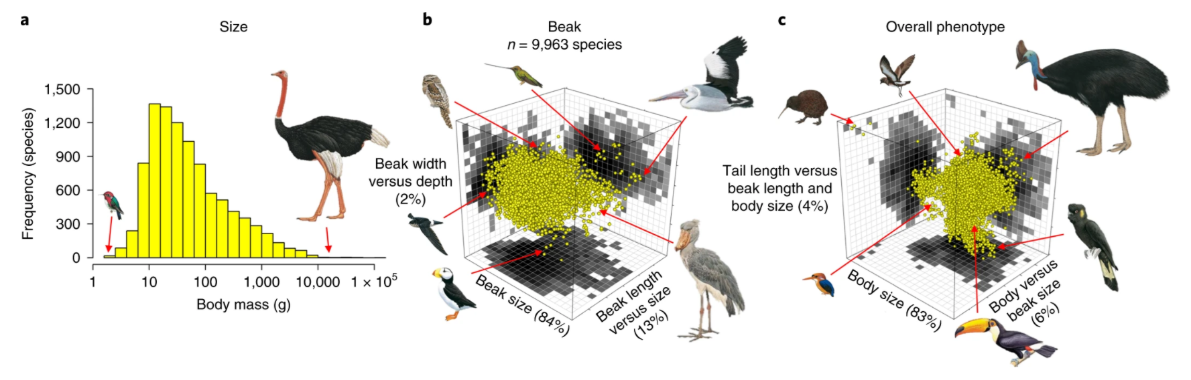
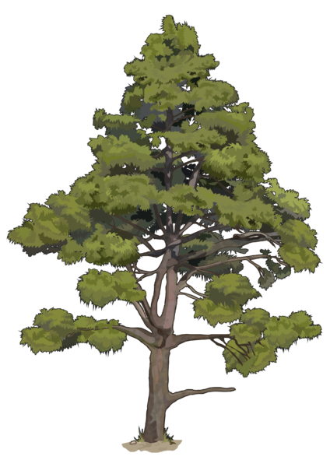

Species trait values - univariate analysis
Scheffer et al 2014.Trends in Ecology & Evolution.
Pigot et al 2020. Nature Ecology & Evolution.
Notes:
UNIVARIATE ANALYSIS
1. The value of traits refers to the presence and relative abundance of certain values of leaf size, nitrogen content, canopy heights, as in CWM.
2. The range of traits refers to the difference between extreme values of these spp characteristics, for example, the range of plant height or body mass.
LEFT: Frequency distribution of plant height for species extracted from the TRY global database of plant traits. Using the highest reported value for each species.
RIGHT: Distribution of avian body masses from the lightest (Mellisuga helenae, 2 g) to the heaviest species (Struthio camelus, 111 kg).
METHOD: a histogram or probability density distribution.

Slide 51
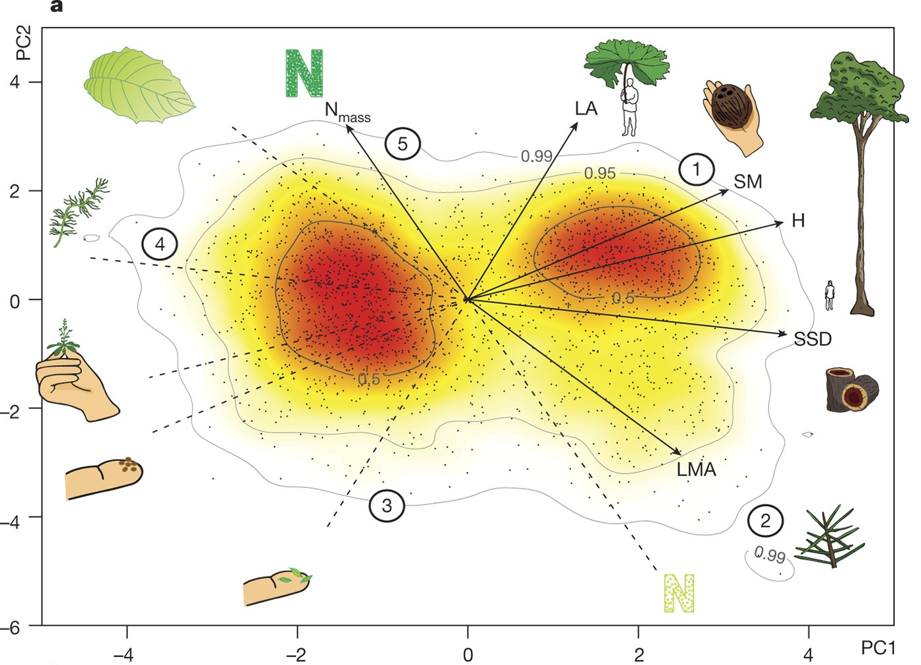
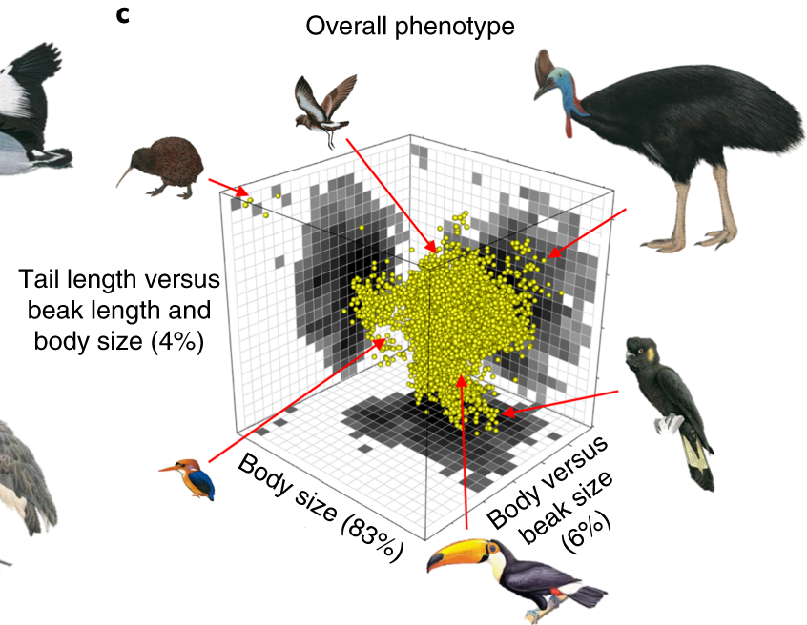
Species trait values - multivariate analysis
The plant 2D – trait space
The avian 3D - trait space
Díaz et al. 2016. Nature.
Pigot et al 2020. Nature Ecology & Evolution.

Slide 52
Species trait combinations
Investments strategies
Conservative
Big plants
Slow-return (conservative)
Fast-return (acquisitive)
Leaf construction
Respiration
Nitrogen concentration
Photosynthesis
Small plants
Acquisitive
Lifespan

Slide 53
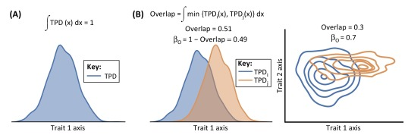
Functional diversity quantification
Univariate analysis
Carmona et al 2016. Trends in ecology & evolution.
Notes:
How can we measure functional diversity?
1. We can do a univariate per analysis per trait.
The -trait probability density TPD- is the relative abundance of trait values.
We can calculate the dissimilarity among traits by calculating the overlap between two TPD functions (i and j). Because TPD functions integrate to 1, the dissimilarity between two ecological units (β_{O}) can be calculated as 1-overlap.
Carmona, C. P., De Bello, F., Mason, N. W., & Lepš, J. (2016). Traits without borders: integrating functional diversity across scales. Trends in ecology & evolution, 31(5), 382-394.

Slide 54

Functional diversity quantification
Multivariate analysis
Mammola & Cardoso (2020). Methods in Ecology and Evolution
Notes:
How can we measure functional diversity?
1. We can do an multivariate analysis with several traits.
Here I show you two examples of mathematical representations of functional diversity (FD) of communities.
Examples are based on two hypothetical traits and two communities, represented in blue and orange.
LEFT: The trait space represented as the minimum convex hull comprising the species occupying the trait space. The functional richness of a community is estimated as the area of the convex hull.
RIGHT: The trait space can be constructed using kernel density hypervolumes, whereby it is approximated as a cloud of stochastic points sampled based on a set of observations (e.g. the traits of the species in the community). The functional richness of the community is estimated as the volume of the hypervolume delineated by the stochastic points
Mammola, S., & Cardoso, P. (2020). Functional diversity metrics using kernel density n‐dimensional hypervolumes. Methods in Ecology and Evolution.

Slide 55

Functional diversity components
Functional richness: total volume of trait space occupied by the species present in a community.
„Convex hull volume“
„Hypervolume“
Community A
Community B
Trait 2
Trait 1
Trait 1
Modified from Villéger et al 2008. Ecology

Slide 56
Functional diversity components
Functional evenness: how regular the distribution of species abundances in traits space is.
Community A
Community B
a<b
Trait 2
Trait 1
Trait 1
Modified from Villéger et al 2008. Ecology
Notes:
Functional evenness (FEve; B) is an indicator of evenness in the distribution of abundance within occupied functional trait space.
Communities where all trait values have a similar probability should have high FEve values.
High FEVE = No dominance of plant strategies

Slide 57
Functional diversity components
Functional dispersion: position of species relative to center of trait space.
Mean distance to centroid
Centroid depends on species abundance. Abundant species have higher weight
Community A
Community B
a<b
Trait 2
Trait 1
Trait 1
Modified from Villéger et al 2008. Ecology
Notes:
High functional divergence indicates a high degree of differentiation. Different plant strategies
communities with high functional divergence may have increased ecosystem function as a result of more efficient resource use. and thus low resource competition.

Slide 58
Functional diversity components
HYPOTHESIS: Dispersal and speciation shape the species assembly
Dispersal
Speciation
Island trait space
Tenerife
Source region
Macaronesia meta-archipelago
Canary Islands
archipelago
Notes:
I expected that dispersal, in particular long-distance, limits the trait combinations, because crossing oceans and adapting to new island environments is challenging for plants.
And this should lead to species sharing similar trait combinations.
In contrast, I expected speciation events via lineage splitting (cladogenesis) to expand the trait space.
This could happen because OI are well known for offering species new ecological opportunities (empty niches) where species can evolve trait combinations.

Slide 59






Functional diversity components
Dispersal
Speciation
Island trait space
Tenerife

Slide 60
Let’s do an exercise!

Slide 61
Functional diversity quantification
Functional richness (volume)
Convex hull
Hypervolume
Blonder 2018
Laliberté et al approach
Blonder approach
It detects possible holes in the trait space.
Notes:
Functional diversity can be measured as the total volume occupied by the hypervolume in multi-dimensional space.
Estimates the minimum convex hull that includes all species in the analysis (Villeger et al 2008). Driven by extreme trait combinations.
But, convex hulls are determined by extreme points and cannot account for possible holes in the trait space.
Gaussian method to build the hypervolumes, as it is the least sensitive method to variation in bandwidth and fits the data loosely, which is suitable for functional diversity and fundamental niche modelling applications (Blonder et al. 2018)

Slide 62


Functional diversity quantification
Do hypervolumes have holes?
Blonder 2016
Notes:
What is the ecological and evolutional meaning of the holes? https://www.journals.uchicago.edu/doi/pdfplus/10.1086/685444
If we dont detect holes we may be overstimating functional diversity. This can lead to wrong comparisons.
Additionally:
Does invasion occur in holes?
Do Species’ Niches Evolve Holes?
Climate change, when describing environmental space of species, holes indicate species do not inhabit these places, e.g., a hypothesis is that species with potential climate niches falling completely within a hole might not be able to migrate to nearby regions with more favorable climate and so become locally extinct (Burrows et al. 2014).

Slide 63

How to estimate functional diversity?
1
Prepare your data
Species by trait Matrix
z –log transformations
Deal with missing values
E.g., use trait imputation
Notes:
How to estimate HV following Blonder approcah
1. Collect/gather you traits.
2. Use tranformation if you trait-data has different order of magnitude. For intance seed mass: there are plants with microscopic seeds (micrograms), to plants with seeds heavier than 20 kg.
3. Deal with missing values. Ideally you impute/predict missing values because delete species with missing data for the calculation of diversity indices may introduce bias (Taugourdeau et al 2014).

Slide 64


How to estimate functional diversity?
2
Reduce dimensionality using PCA analysis.
Use the first 3 components to estimate hypervolumes.
Or decide which traits will be included in the analysis (orthogonal traits?).
PCA analysis using 10 plant traits and 439 native species of Tenerife island.
Notes:
You should use the lowest dimensionality possible for the Blonder approach.

Slide 65
How to estimate functional diversity?
3
library(hypervolume) estimation functional diversity
Principal coordinates analysis is performed on the species-species distance matrix.
The resulting PCA axes are used as the new ‘traits’ to compute the three indices Functional richness, evenness and dispersion
https://benjaminblonder.org/hypervolume_faq.html
Notes:
FD A distance-based framework to compute multidimensional functional diversity
Once the species-species distance matrix is obtained, if variables are continuous then axes can be represented in Euclidean space.
Principal coordinates analysis (PCoA) is performed on the corrected species-species distance matrix. The resulting PCoA axes are used as the new ‘traits’ to compute the three indices of Villéger et al. (2008): FRic, FEve, and FDiv. For FEve, there is no limit on the number of traits that can be used, so all PCoA axes are used.
While PCA is based on Euclidean distances, PCoA can handle (dis)similarity matrices calculated from quantitative, semi-quantitative, qualitative, and mixed variables.

Slide 66






Methods
Notes:
Seminal studies
What you find in the literature. DECADES of high DEVELOPMENT OF FD STUDIES
Methodological papers

Slide 67





Ecological questions

